Slide 1
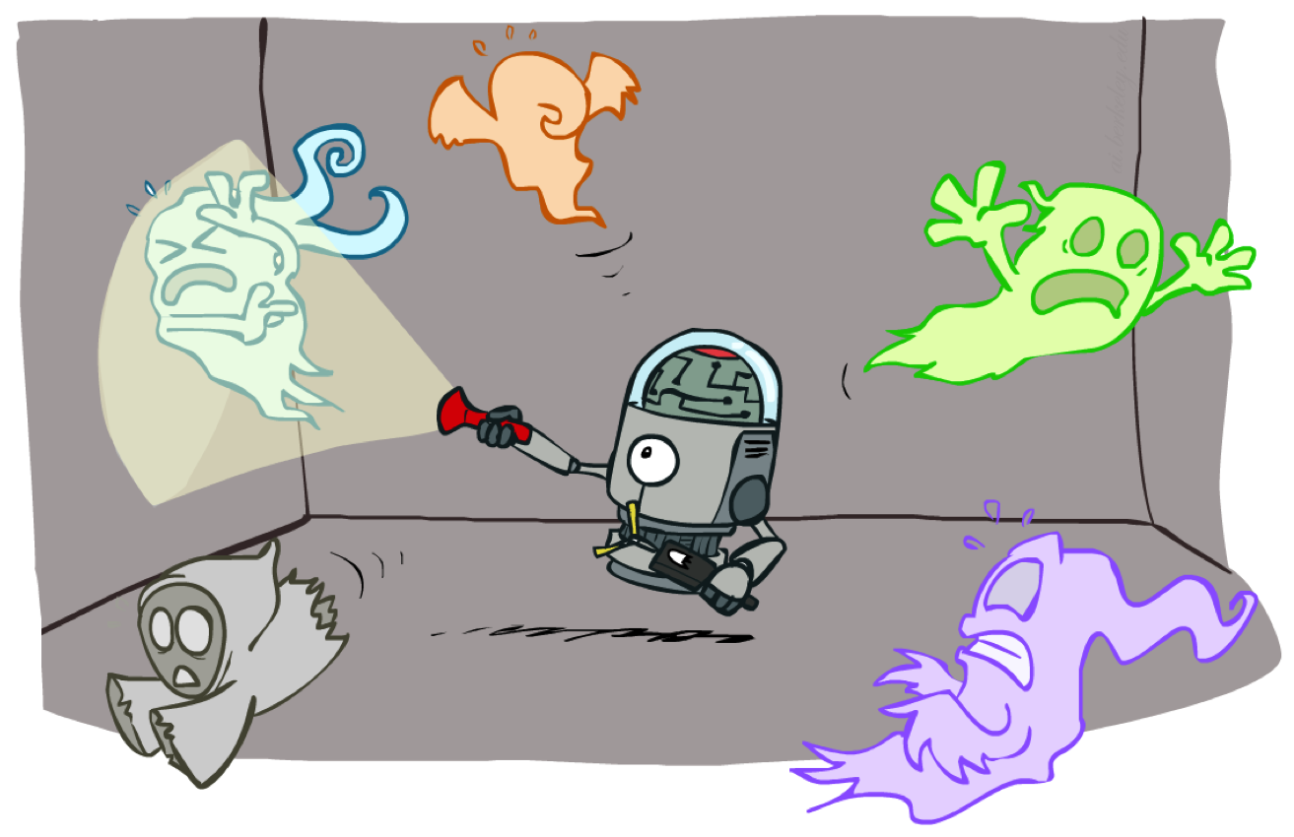
CS 317: Artificial Intelligence
HMMs, Particle Filters, and Applications
Instructors: Dan Klein and Pieter Abbeel
University of California, Berkeley
[These slides were created by Dan Klein and Pieter Abbeel for CS188 Intro to AI at UC Berkeley. All CS188 materials are available at http://ai.berkeley.edu.]
Notes:
Please retain proper attribution, including the reference to ai.berkeley.edu. Thanks!

Slide 2
Today
HMMs
Particle filters
Most-likely-explanation queries
Applications:
Robot localization / mapping
Speech recognition (later)

Slide 3



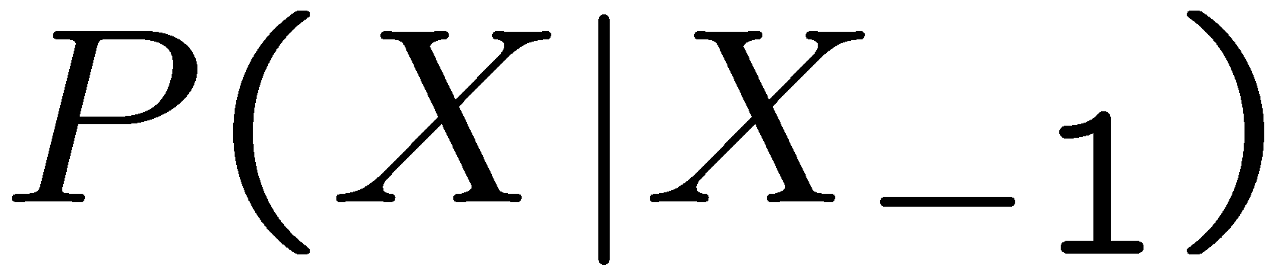

Recap: Reasoning Over Time
[Demo: Ghostbusters Markov Model (L15D1)]
Markov models
Hidden Markov models
0.3
0.7
X₁
X₂
X₃
X₄
rain
sun
0.7
0.3
X₁
X₂
X₃
X₄
X₅
X | E | P
rain | umbrella | 0.9
rain | no umbrella | 0.1
sun | umbrella | 0.2
sun | no umbrella | 0.8
E₁
E₂
E₃
E₄
E₅

Slide 4
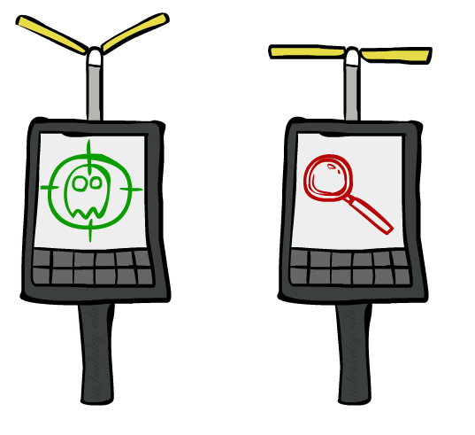

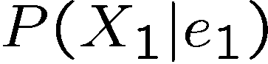
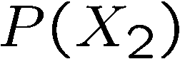
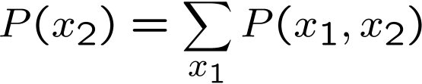
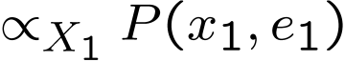
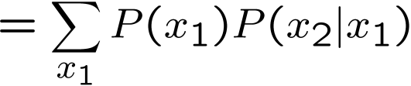
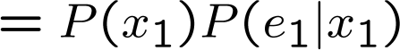
Inference: Base Cases
X₁
X₁
X₂
E₁

Slide 5
Inference: Base Cases
X₁
X₂

Slide 6
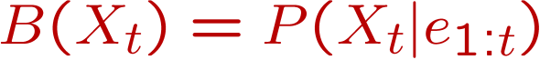
Passage of Time
Assume we have current belief P(X | evidence to date)
Then, after one time step passes:
Basic idea: beliefs get “pushed” through the transitions
With the “B” notation, we have to be careful about what time step t the belief is about, and what evidence it includes
X₁
X₂
Or compactly:
Notes:
TODO: intermediate step in derivation!

Slide 7

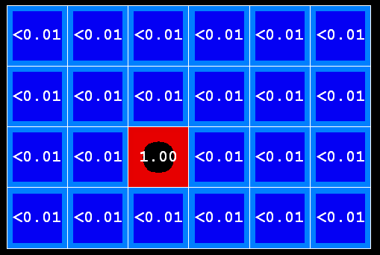
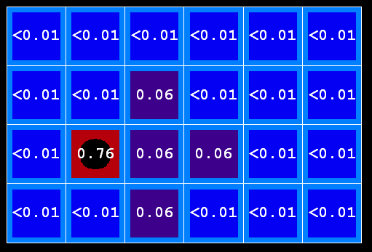
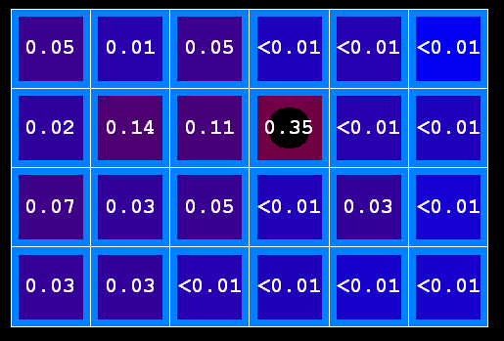
Example: Passage of Time
As time passes, uncertainty “accumulates”
(Transition model: ghosts usually go clockwise)
T = 1
T = 2
T = 5

Slide 8
Inference: Base Cases
X₁
E₁

Slide 9
Observation
X₁
Assume we have current belief P(X | previous evidence):
Then, after evidence comes in:
Or, compactly:
E₁
Basic idea: beliefs “reweighted” by likelihood of evidence
Unlike passage of time, we have to renormalize
Notes:
Basic idea: beliefs “reweighted” by likelihood of evidence
Unlike passage of time, we have to renormalize

Slide 10


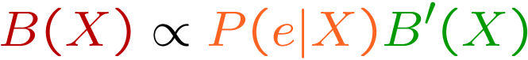
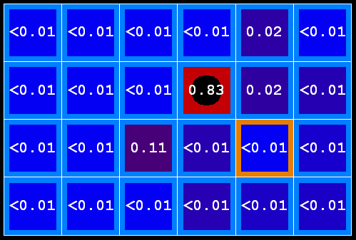
Example: Observation
As we get observations, beliefs get reweighted, uncertainty “decreases”
Before observation
After observation

Slide 11
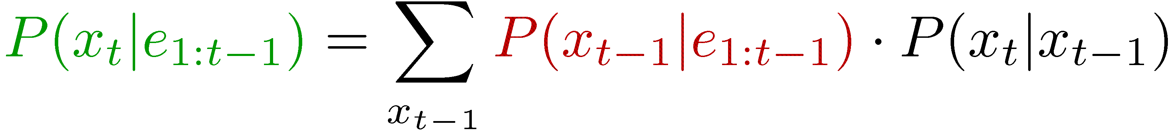
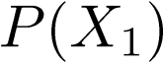
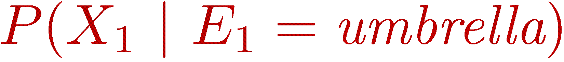
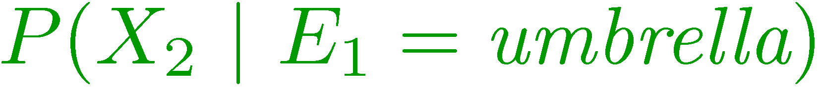
Filtering
Elapse time: compute P( X_{t} | e_{1:t-1} ) Observe: compute P( X_{t} | e_{1:t} )
Belief: <P(rain), P(sun)>
X₁
X₂
<0.5, 0.5>
Prior on X₁
<0.82, 0.18>
Observe
E₁
E₂
<0.63, 0.37>
Elapse time
<0.88, 0.12>
Observe
[Demo: Ghostbusters Exact Filtering (L15D2)]

Slide 12
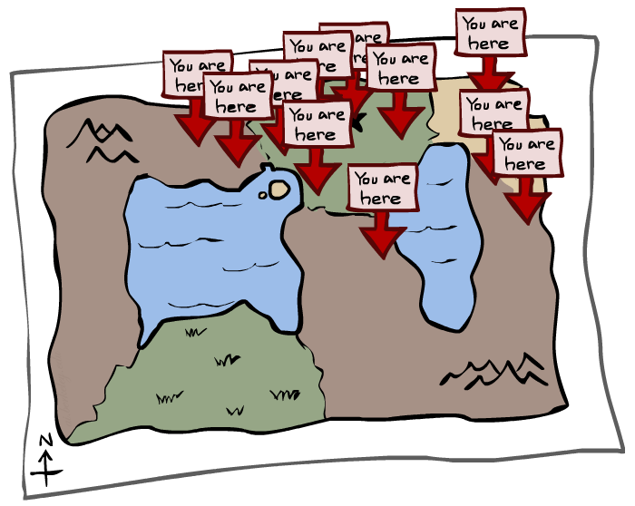
Particle Filtering

Slide 13
Particle Filtering
Filtering: approximate solution
Sometimes |X| is too big to use exact inference
|X| may be too big to even store B(X)
E.g. X is continuous
Solution: approximate inference
Track samples of X, not all values
Samples are called particles
Time per step is linear in the number of samples
But: number needed may be large
In memory: list of particles, not states
This is how robot localization works in practice
Particle is just new name for sample
0.0
0.1
0.0
0.0
0.0
0.2
0.0
0.2
0.5

Slide 14
Representation: Particles
Our representation of P(X) is now a list of N particles (samples)
Generally, N << |X|
Storing map from X to counts would defeat the point
P(x) approximated by number of particles with value x
So, many x may have P(x) = 0!
More particles, more accuracy
For now, all particles have a weight of 1
Particles:
(3,3)
(2,3)
(3,3)
(3,2)
(3,3)
(3,2)
(1,2)
(3,3)
(3,3)
(2,3)

Slide 15
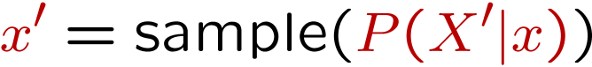
Particle Filtering: Elapse Time
Each particle is moved by sampling its next position from the transition model
This is like prior sampling – samples’ frequencies reflect the transition probabilities
Here, most samples move clockwise, but some move in another direction or stay in place
This captures the passage of time
If enough samples, close to exact values before and after (consistent)
Particles:
(3,3)
(2,3)
(3,3)
(3,2)
(3,3)
(3,2)
(1,2)
(3,3)
(3,3)
(2,3)
Particles:
(3,2)
(2,3)
(3,2)
(3,1)
(3,3)
(3,2)
(1,3)
(2,3)
(3,2)
(2,2)

Slide 16
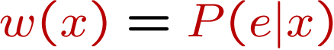
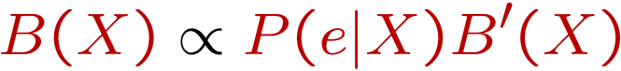
Particle Filtering: Observe
Particles:
(3,2)
(2,3)
(3,2)
(3,1)
(3,3)
(3,2)
(1,3)
(2,3)
(3,2)
(2,2)
Slightly trickier:
Don’t sample observation, fix it
Similar to likelihood weighting, downweight samples based on the evidence
As before, the probabilities don’t sum to one, since all have been downweighted (in fact they now sum to (N times) an approximation of P(e))
Particles:
(3,2) w=.9
(2,3) w=.2
(3,2) w=.9
(3,1) w=.4
(3,3) w=.4
(3,2) w=.9
(1,3) w=.1
(2,3) w=.2
(3,2) w=.9
(2,2) w=.4

Slide 17
Particle Filtering: Resample
Rather than tracking weighted samples, we resample
N times, we choose from our weighted sample distribution (i.e. draw with replacement)
This is equivalent to renormalizing the distribution
Now the update is complete for this time step, continue with the next one
Particles:
(3,2) w=.9
(2,3) w=.2
(3,2) w=.9
(3,1) w=.4
(3,3) w=.4
(3,2) w=.9
(1,3) w=.1
(2,3) w=.2
(3,2) w=.9
(2,2) w=.4
(New) Particles:
(3,2)
(2,2)
(3,2)
(2,3)
(3,3)
(3,2)
(1,3)
(2,3)
(3,2)
(3,2)

Slide 18
Recap: Particle Filtering
Particles: track samples of states rather than an explicit distribution
Elapse
Weight
Resample
Particles:
(3,3)
(2,3)
(3,3)
(3,2)
(3,3)
(3,2)
(1,2)
(3,3)
(3,3)
(2,3)
Particles:
(3,2)
(2,3)
(3,2)
(3,1)
(3,3)
(3,2)
(1,3)
(2,3)
(3,2)
(2,2)
Particles:
(3,2) w=.9
(2,3) w=.2
(3,2) w=.9
(3,1) w=.4
(3,3) w=.4
(3,2) w=.9
(1,3) w=.1
(2,3) w=.2
(3,2) w=.9
(2,2) w=.4
(New) Particles:
(3,2)
(2,2)
(3,2)
(2,3)
(3,3)
(3,2)
(1,3)
(2,3)
(3,2)
(3,2)
[Demos: ghostbusters particle filtering (L15D3,4,5)]

Slide 19
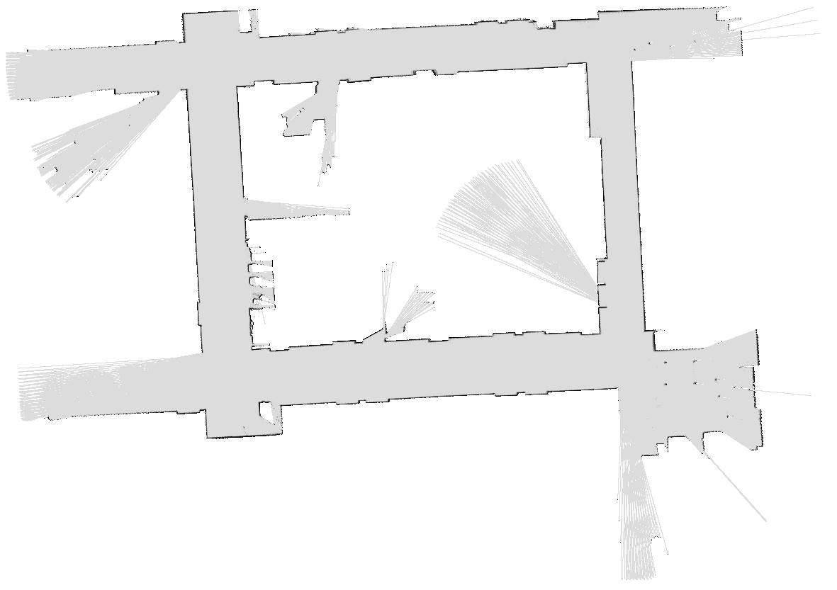

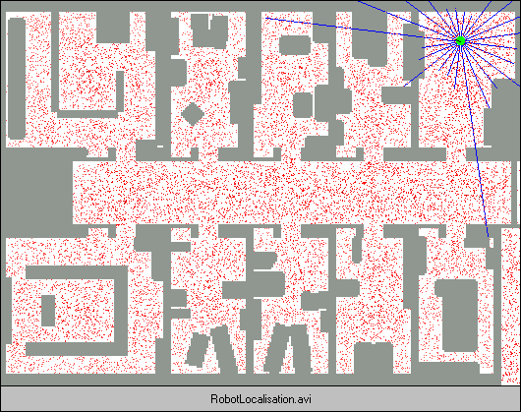
More Demos!

Slide 20
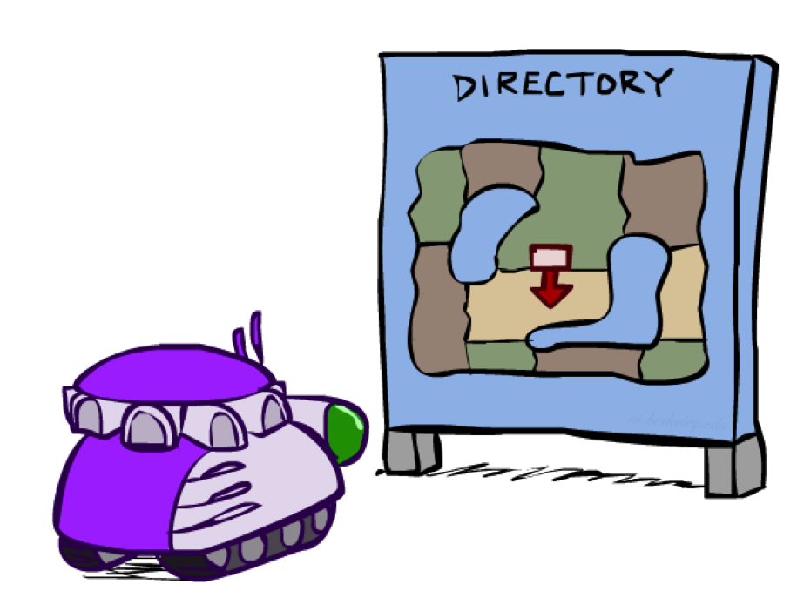
Robot Localization
In robot localization:
We know the map, but not the robot’s position
Observations may be vectors of range finder readings
State space and readings are typically continuous (works basically like a very fine grid) and so we cannot store B(X)
Particle filtering is a main technique

Slide 21

Particle Filter Localization (Sonar)
[Video: global-sonar-uw-annotated.avi]

Slide 22
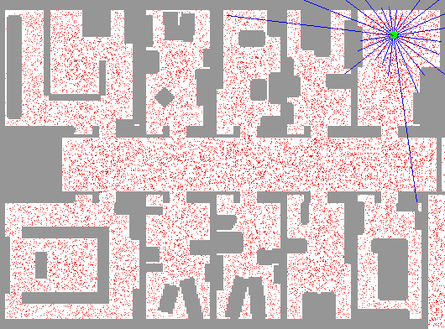
Particle Filter Localization (Laser)
[Video: global-floor.gif]

Slide 23
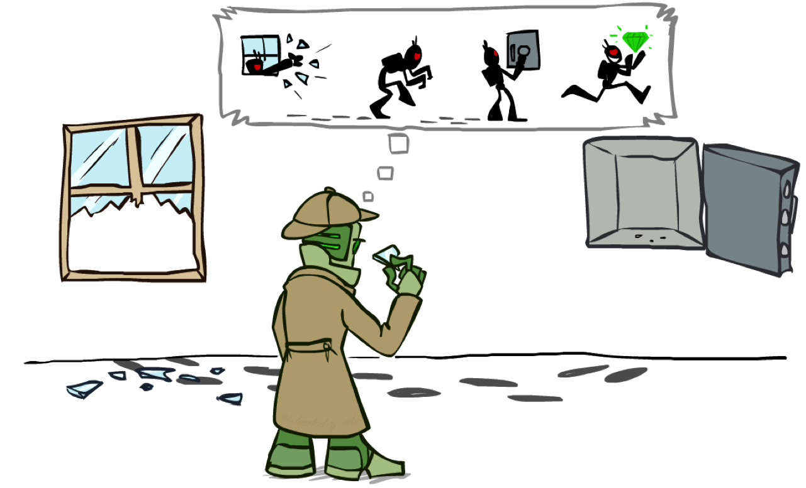
Most Likely Explanation

Slide 24

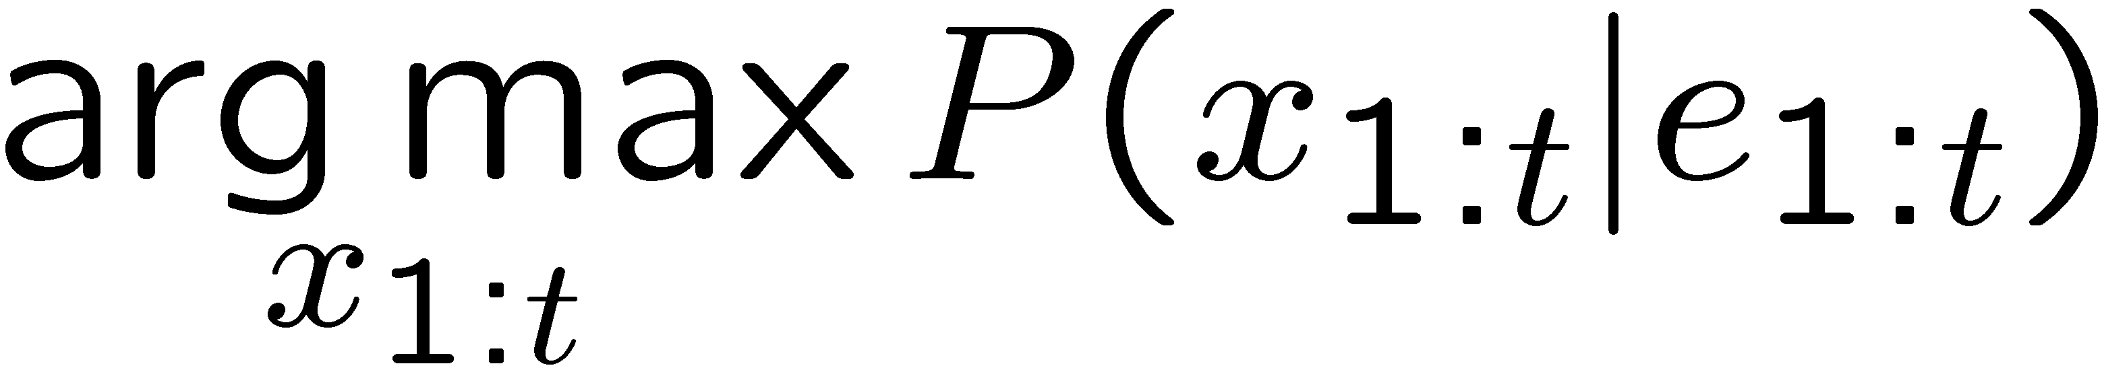
HMMs: MLE Queries
HMMs defined by
States X
Observations E
Initial distribution:
Transitions:
Emissions:
New query: most likely explanation:
New method: the Viterbi algorithm
X₁
X₂
X₃
X₄
X₅
E₁
E₂
E₃
E₄
E₅

Slide 25
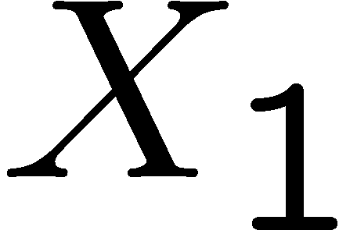
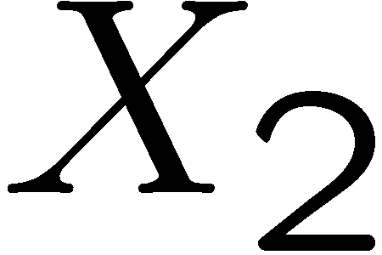

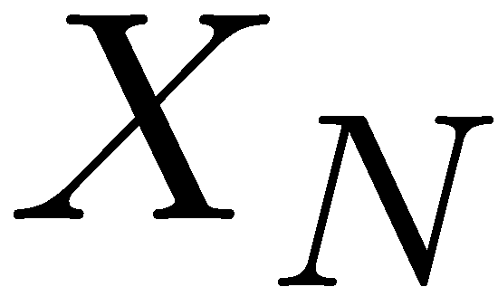

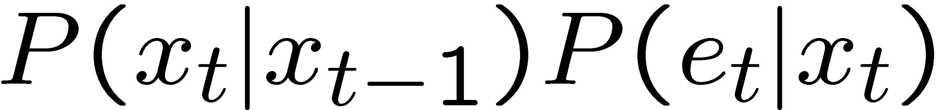
State Trellis
State trellis: graph of states and transitions over time
Each arc represents some transition
Each arc has weight
Each path is a sequence of states
The product of weights on a path is that sequence’s probability along with the evidence
Forward algorithm computes sums of paths, Viterbi computes best paths
sun
sun
sun
sun
rain
rain
rain
rain

Slide 26
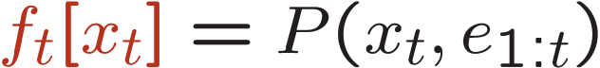
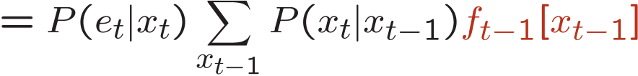
Forward / Viterbi Algorithms
sun
sun
sun
sun
rain
rain
rain
rain
Forward Algorithm (Sum)
Viterbi Algorithm (Max)

Slide 27

Speech Recognition

Slide 28

Digitizing Speech

Slide 29
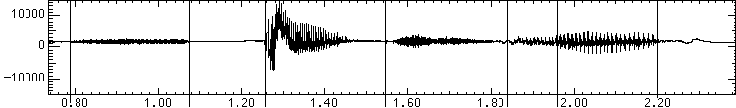
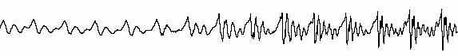
Speech in an Hour
Speech input is an acoustic waveform
s p ee ch l a b
“l” to “a”
transition:
Figure: Simon Arnfield, http://www.psyc.leeds.ac.uk/research/cogn/speech/tutorial/

Slide 30
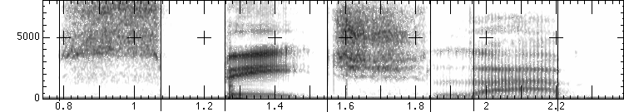
Acoustic Feature Sequence
Time slices are translated into acoustic feature vectors (~39 real numbers per slice)
These are the observations E, now we need the hidden states X
frequency
……………………………………………..e₁₂e₁₃e₁₄e₁₅e₁₆………..

Slide 31
Speech State Space
HMM Specification
P(E|X) encodes which acoustic vectors are appropriate for each phoneme (each kind of sound)
P(X|X’) encodes how sounds can be strung together
State Space
We will have one state for each sound in each word
Mostly, states advance sound by sound
Build a little state graph for each word and chain them together to form the state space X

Slide 32
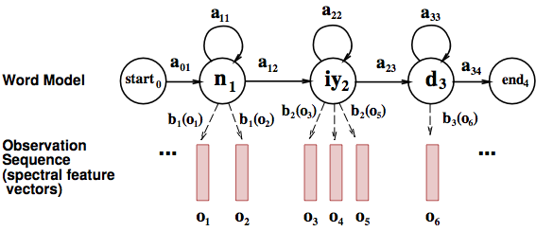
States in a Word

Slide 33
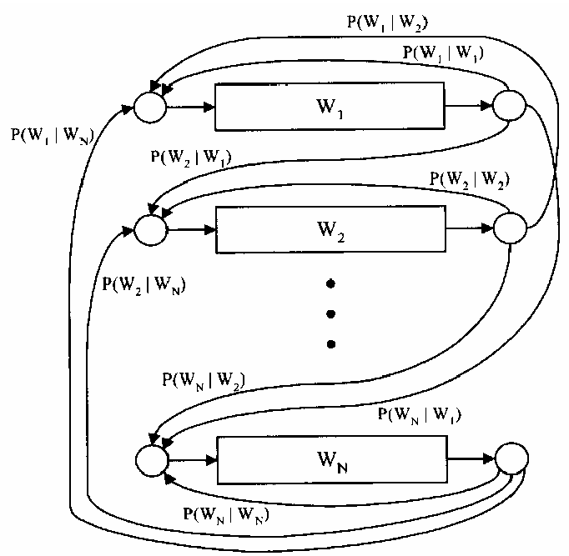
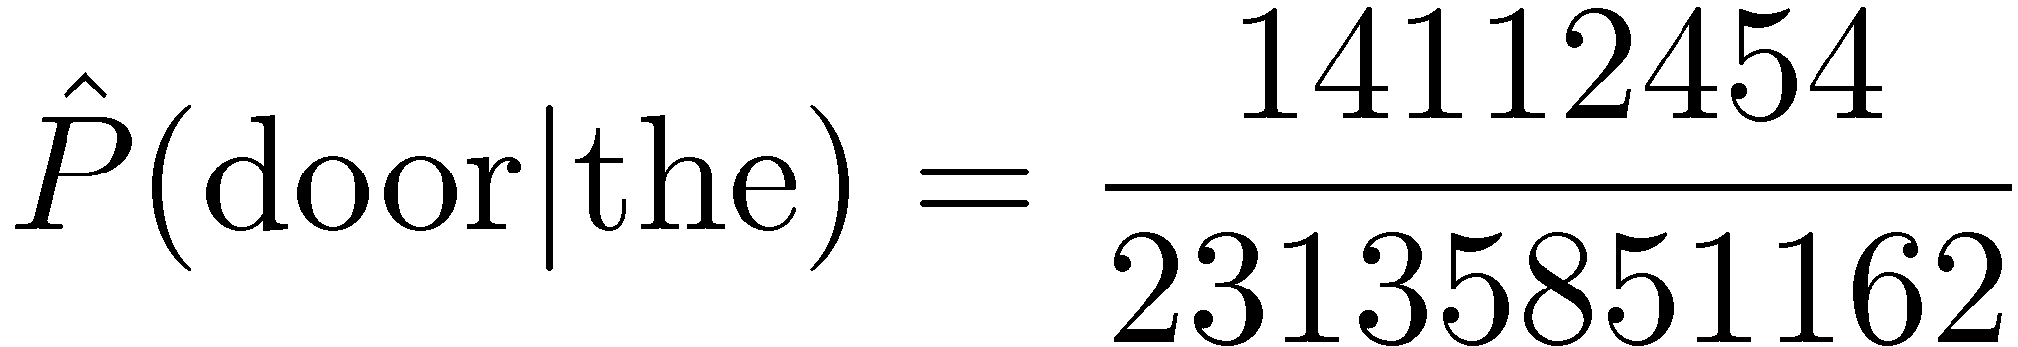
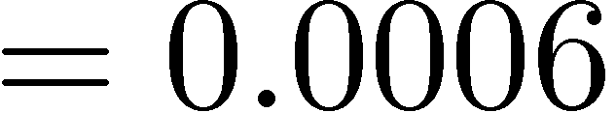
Transitions with a Bigram Model
198015222 the first
194623024 the same
168504105 the following
158562063 the world
…
14112454 the door
-----------------------------------
23135851162 the *
Training Counts
Figure: Huang et al, p. 618

Slide 34
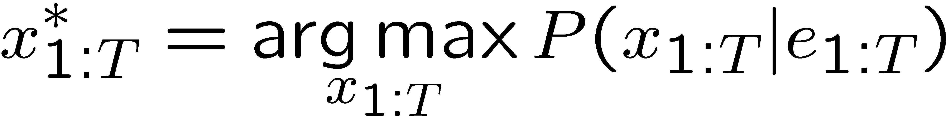
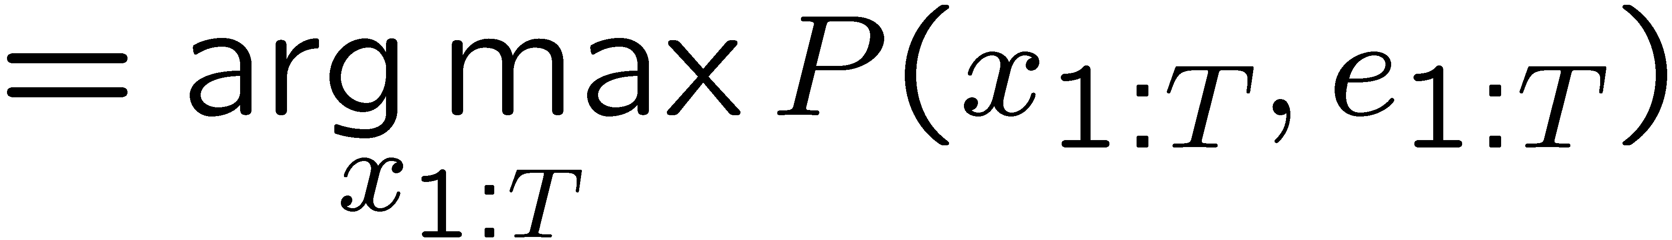

Decoding
Finding the words given the acoustics is an HMM inference problem
Which state sequence x_{1:T} is most likely given the evidence e_{1:T}?
From the sequence x, we can simply read off the words

